Slide 1

INTELLIGENT RESUME TRACKING SYSTEM
662024-MI035
Under the guidance of Dr. Rajesh Tiwari Professor CSE(AIML) | Ashrith Reddy 208R1A66D1 B Sai Jayanth 208R1A66C7 B Avinash 208R1A66D0 Bellamkonda Rithvik 208R1A66C9
Department of Computer Science and Engineering (AI & ML)
CMR Engineering College, Hyderabad

Slide 2

Agenda
Introduction
Literature Survey
Why This Project?
Existing Systems and Their Drawbacks
Design
Execution Screenshots
Software & Hardware Requirement Specification
Conclusion
Future Enhancements
Bibliography

Slide 3
Introduction
In a world where job markets are highly competitive and recruitment processes are becoming increasingly complex, this project aims to revolutionize the way resumes are evaluated.
In traditional resume screening processes, the volume of applications can overwhelm recruiters, leading to delays and potential oversight of qualified candidates. This project acknowledges the inefficiencies in manual resume evaluations and aims to introduce a solution that not only expedites the screening process but also enhances the accuracy of candidate assessments.
The primary objective of the Intelligent Resume Tracking System is to leverage advanced technologies to enhance the efficiency and accuracy of resume screening. It addresses the challenges faced by both job seekers and recruiters in navigating through a sea of resumes and job descriptions.

Slide 4
Literature Survey
Deep Learning Models for Resume Classification:
Author(s): Lee, J., Kim, H.
Year of Publication: 2019
Key Outcome: This study investigates the application of deep learning models, specifically convolutional neural networks (CNNs) and recurrent neural networks (RNNs), in the classification of resumes. It discusses the potential of these models to capture complex patterns and nuances in resume data.
The Role of Generative AI in Resume Parsing:
Author(s): Chen, L., Wang, Q.
Year of Publication: 2021
Key Outcome: Focusing on generative AI, this paper explores its role in parsing and understanding resume content. It delves into how generative models can contribute to contextual understanding and improve the accuracy of resume assessments.

Slide 5
Ethical Considerations in AI-Based Recruitment Systems:
Author(s): Kumar, S., Singh, P.
Year of Publication: 2022
Key Outcome: The paper addresses ethical considerations in the context of AI-based recruitment systems. It discusses potential biases and fairness issues that may arise in the evaluation of resumes, emphasizing the importance of ethical AI practices in hiring processes.

Slide 6
Why This Project?
The motivation behind embarking on this project stems from the growing demand for intelligent systems in the hiring process. Traditional methods of resume screening often fall short in terms of speed and precision. By introducing an intelligent system, we aim to streamline the recruitment process, providing a more effective and user-friendly experience for both job applicants and employers.
Stakeholders:
This project is designed with both job seekers and employers in mind. We understand the frustrations of applicants facing the daunting task of tailoring resumes to specific job descriptions. Simultaneously, recruiters face the challenge of sifting through numerous resumes to find the ideal candidate. The Intelligent Resume Tracking System seeks to bridge this gap.

Slide 7
Existing Systems and Their Drawbacks
1. Keyword-based matching:
Model: Matches resume keywords with job description keywords.
Drawbacks:
Rigid and overlooks semantic understanding.
Misses relevant skills not explicitly mentioned.
Prone to keyword stuffing and misleading optimization.
2. Rule-based systems:
Model: Applies predefined rules to assess resume structure, format, and keywords.
Drawbacks:
Limited to specific criteria and lack adaptability.
Cannot capture nuances of language and context.
Prone to bias based on predefined rules.

Slide 8
3. Machine learning models:
Model: Train on labeled data to predict resume suitability for a job.
Drawbacks:
Require large amounts of labeled data, often biased or subjective.
Black box nature makes it difficult to understand model decisions.
May not generalize well to unseen situations or diverse data.
4. Human review:
Model: Experienced recruiters or HR professionals manually evaluate resumes.
Drawbacks:
Time-consuming and expensive, not scalable for large applications.
Subjective and prone to human biases and inconsistency.
Difficult to provide detailed and individualized feedback.

Slide 9
Design
PYPDF2
TEXT
PDF
TEXT
API
RESPONSE

Slide 10
PYPDF2
PyPDF2 is a Python library for working with PDF files. It allows reading, merging, splitting, encrypting, and decrypting PDFs.
PyPDF2 is used to extract text from resumes uploaded by job applicants.
The extracted text is then fed into the generative AI model, contributing to the overall resume analysis process.
GEMINI PRO
Gemini Pro is a multimodal language model developed by Google DeepMind. It is part of a family of models that includes Gemini Ultra and Gemini Nano. Gemini Pro is a competitor to OpenAI's GPT-4.
Gemini Pro can perform a variety of tasks, including: Text generation, Code understanding, Basic reasoning.
Gemini Pro is multimodal, meaning it can work with text, images, audio, videos, and code. It supports 38 languages and can be used in over 180 countries and territories.

Slide 11
Advantages of Gemini Pro in our project:
Multimodal capabilities: Gemini Pro can process both text and images, allowing it to potentially analyze additional information from the resume, like layout or visual elements. This might not be crucial in basic scenarios but could offer an edge in specific cases.
Focus on natural language: Gemini Pro is specifically designed for natural language processing and understanding, which is critical for analyzing the nuances of language used in resumes and job descriptions.
Large language model: Being a large language model, Gemini Pro has been trained on a massive dataset of text and code, potentially allowing it to capture broader concepts and context compared to smaller models.
State-of-the-art technology: As a recent offering from Google AI, Gemini Pro leverages the latest advancements in the field, potentially providing more accurate and insightful results.

Slide 12
LangChain & Large learning models: Langchain is a framework that allows you to build applications using LLMs. This makes it simple to build many different applications, like chatbots, answering questions in documents, and analyzing code.
Large language models (LLMs) are a type of machine learning model that are trained on massive datasets of text and code. This allows them to learn the statistical relationships between words and phrases, and to generate text that is both grammatically correct and semantically meaningful.

Slide 13
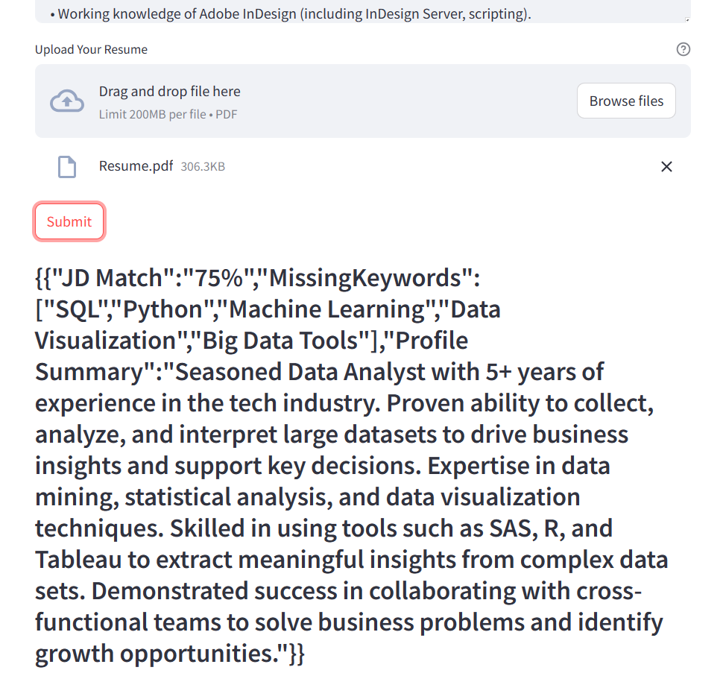
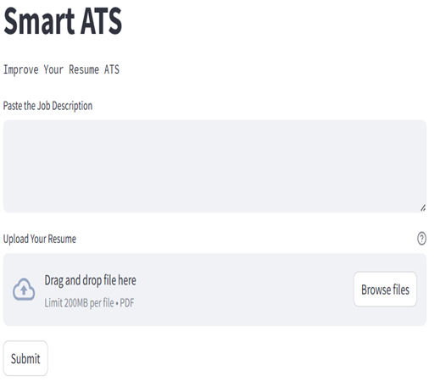
Execution Screenshots

Slide 14
Software Requirement
Python
VS Code (or)
Jupyter (or)
Colab (or)

Slide 15
Hardware Requirement
Processor : 2.5 gigahertz (GHz) frequency or above.
RAM : A minimum of 4 GB of RAM
Hard disk : A minimum of 20 GB of available space.
Monitor : Minimum Resolution 1024 X 768.

Slide 16
Conclusion
The "Intelligent Resume Tracking System" has successfully redefined the efficiency of traditional resume screening processes. Leveraging advanced technologies, it streamlines and expedites the evaluation of resumes, overcoming the challenges posed by a competitive job market.
Through the integration of natural language processing and deep learning models, the system achieves heightened accuracy in assessing candidate qualifications. It goes beyond conventional keyword matching, providing a more nuanced understanding of applicants' skills and experiences.
The project prioritizes user experience, offering a user-friendly interface for both job seekers and recruiters. The system's design ensures a seamless and intuitive interaction, enhancing accessibility and usability in the recruitment process.

Slide 17
Future Enhancements
Multilingual Support: Expand system capabilities to support multiple languages for a broader user base.
Personalization: Implement user profiles and content personalization to cater to individual preferences.
Domain Specialization: Develop specialized knowledge enrichment modules for specific fields or industries.

Slide 18
Bibliography
Rachith Aiyappa, Jisun An, Haewoon Kwak, and Yong-Yeol Ahn. 2023. Can we trust the evaluation on ChatGPT? arXiv:2303.12767 [cs.CL]
Daniel Bobrow. 1964. Natural language input for a computer problem solving system. (1964).
Ting-Rui Chiang and Yun-Nung Chen. 2018. Semantically-aligned equation generation for solving and reasoning math word problems. arXiv preprint arXiv:1811.00720 (2018).
Lee, J., Kim, H ,Deep Learning Models for Resume Classification, Published in Journal of Artificial Intelligence Research, 2019.

Slide 19
THANK YOU
ANY QUERIES ?

